Slide 1
Lecture 6
Public Key Cryptography

Slide 2
INTRODUCTION
Categories of ciphers:
Symmetric ciphers
stream ciphers
block ciphers
Public key cryptosystems

Slide 3
INTRODUCTION
In symmetric key cryptography, the same key is used to both encrypt and decrypt.
In public key cryptography, one key is used to encrypt and a different key is used to decrypt.
This solves one of the most vexing problems of symmetric key crypto, namely, how to securely distribute the symmetric key.
So why not use public key crypto for everything?
The primary reason is speed. Symmetric key crypto is orders of magnitude faster than public key crypto. As a result, symmetric key crypto is used to encrypt the vast majority of data today.
We’ll examine some of the most important public key cryptosystems.
A public key cryptosystem is based on a “trap door one-way function,” that is, a function that is easy to compute in one direction and hard to compute in other direction.
The purpose of the trap door is to ensure that an attacker cannot use the public information to recover the secret information.
For example, it is relatively easy to generate two prime numbers p and q and compute their product N = pq. But, given N, it is difficult (as far as is known) to find its factors p and q.

Slide 4
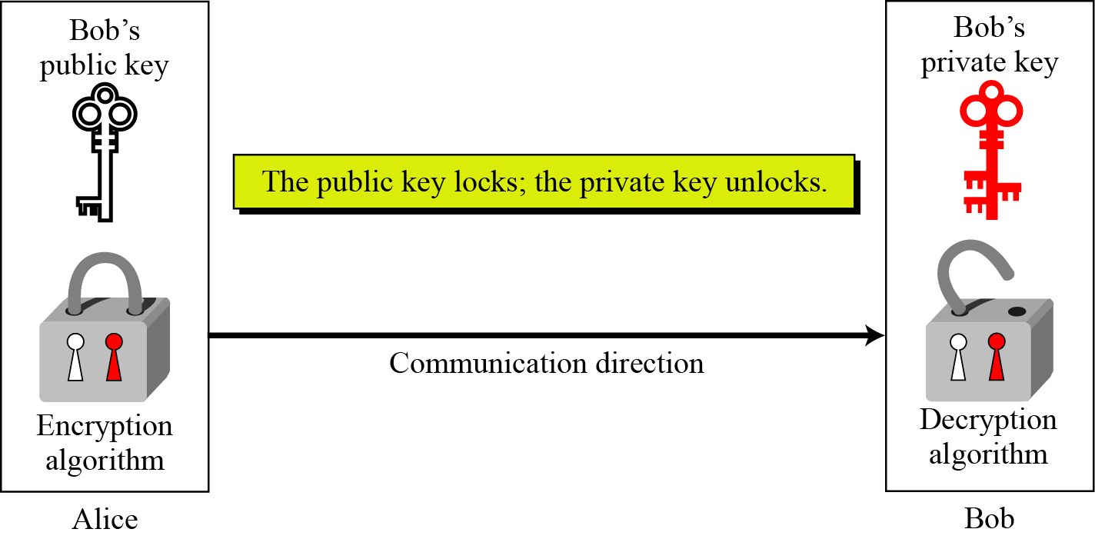
INTRODUCTION
To do public key crypto, Bob must have a key pair consisting of a public key and a private key.
Anyone can use Bob’s public key to encrypt a message for Bob, but only Bob can decrypt the message, since only Bob has the private key.
Locking and unlocking in asymmetric-key cryptosystem

Slide 5
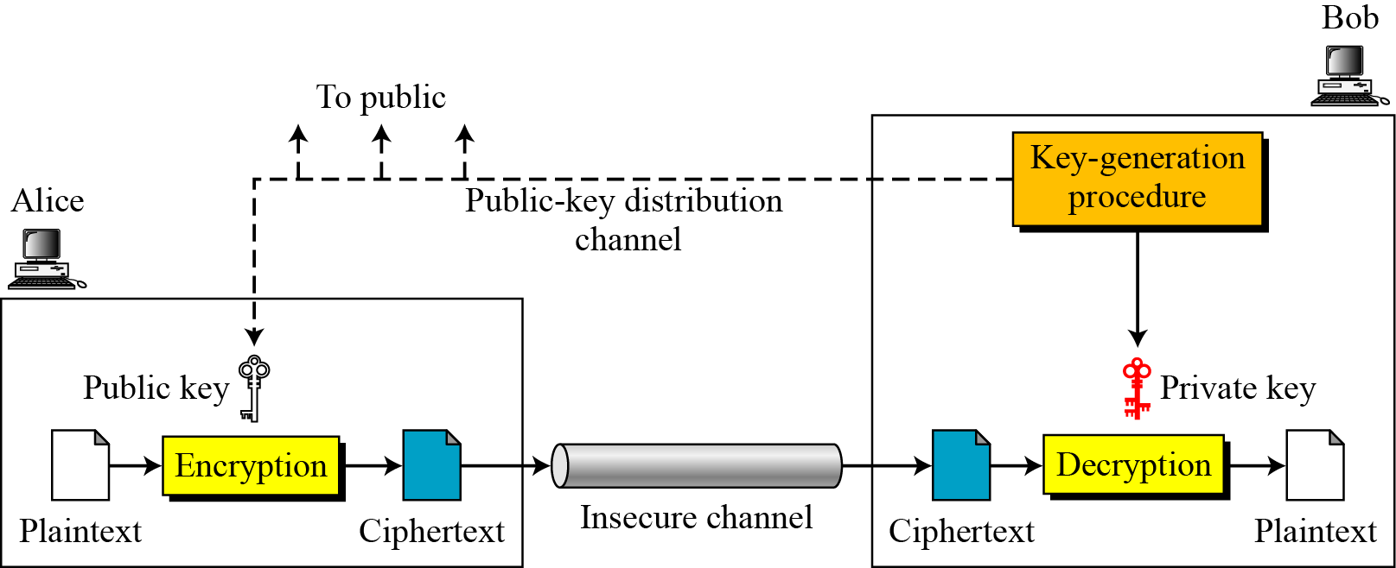
General Idea

Slide 6
PUBLIC KEY CRYPTO
We’ll discuss several public key cryptosystems.
The first one that we’ll consider is the knapsack cryptosystem.
This is appropriate since the knapsack was one of the first proposed public key systems. Although the knapsack that we’ll present is known to be insecure, it’s an easily understood system.
After the knapsack, we’ll discuss the gold standard of public key crypto, RSA.

Slide 7
KNAPSACK
The knapsack problem can be stated as follows. Given a set of n weights
W0, W1,...,Wn−1
and sum S, find a0, a1,...,an−1, where each ai ∈ {0, 1}, so that
S = a0W0 + a1W1 +···+ an−1Wn−1 provided this is possible.
For example, suppose the weights are 85, 13, 9, 7, 47, 27, 99, 86 and the desired sum is S = 172.
Then a solution to the problem exists and is given by
a = (a0, a1, a2, a3, a4, a5, a6, a7) = (11001100)
since 85 + 13 + 47 + 27 = 172.

Slide 8
Superincreasing knapsack
A superincreasing knapsack, is similar to the general knapsack except that when the weights are arranged from least to greatest, each weight is greater than sum of all previous weights.
For example:
3, 6, 11, 25, 46, 95, 200, 411 (4.1)
is a superincreasing knapsack.
Solving a superincreasing knapsack problem is easy.
Suppose we are given the set of weights in equation 4.1 and the sum S = 309.
To solve this, we simply start with the largest weight and work toward the smallest to recover the ai in linear time.
Since S < 411, we have a7 = 0.
Then since S > 200, we have a6 = 1 and we let S = S − 200 = 109.
Then since S > 95, we have a5 = 1 and we let S = S − 95 = 14.
Continuing in this manner, we find a = 10100110, which we can easily verify solves the problem since 3 + 11 + 95 + 200 = 309.

Slide 9
knapsack cryptosystem
A public key crpytosystem can be constructed based on the knapsack problem by
Generate a superincreasing knapsack.
Convert the superincreasing knapsack into a "general" knapsack by multiplying all of the numbers by m mod n, where n is greater than the sum of all numbers in the knapsack and the m has no factor in common with n.
The superincreasing knapsack, together with m and n, is the private key.
The corresponding general knapsack is the public key.
It is easy to encrypt using the general knapsack; simply add all elements in the 1's positions.
Given the private key, the ciphertext can be converted to a superincreasing knapsack, which is then easily solved to decrypt the message.

Slide 10
Example 1
Let the private key be the superincreasing knapsack {2,3,6,13,27,52} and choose m= 31 and n = 105 Then the general knapsack is computed as 2⋅31 mod 105 = 62 3⋅31 mod 105 = 93 6⋅31 mod 105 = 81 13⋅31 mod 105 = 88 27⋅31 mod 105 = 102 51⋅31 mod 105 = 37 and the public key is {62,93,81,88,102,37}.

Slide 11
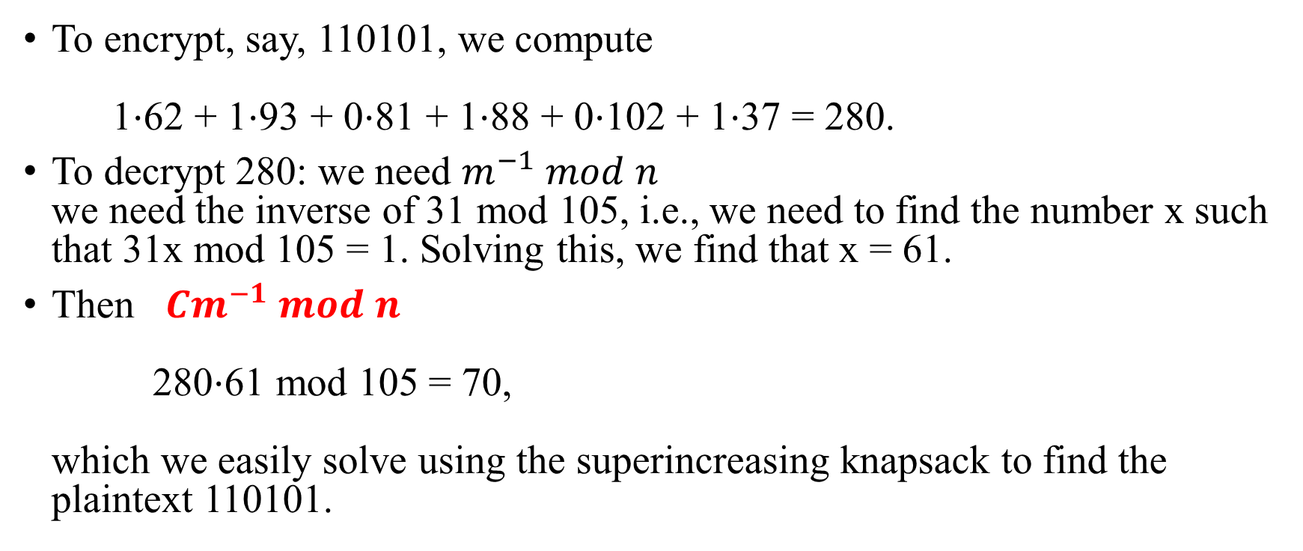
Example 1
To encrypt, say, 110101, we compute 1⋅62 + 1⋅93 + 0⋅81 + 1⋅88 + 0⋅102 + 1⋅37 = 280.
To decrypt 280: we need $m^{−1} mod n$ we need the inverse of 31 mod 105, i.e., we need to find the number x such that 31x mod 105 = 1. Solving this, we find that x = 61.
Then $Cm^{−1} mod n$ 280⋅61 mod 105 = 70, which we easily solve using the superincreasing knapsack to find the plaintext 110101.

Slide 12
Example 2
The superincreasing knapsack
(2, 3, 7, 14, 30, 57, 120, 251)
m = 41 and n = 491
Then the general knapsack is computed from the superincreasing knapsack by modular multiplication
2m = 2 · 41 = 82 mod 491
3m = 3 · 41 = 123 mod 491
7m = 7 · 41 = 287 mod 491
14m = 14 · 41 = 83 mod 491
30m = 30 · 41 = 248 mod 491
57m = 57 · 41 = 373 mod 491
120m = 120 · 41 = 10 mod 491
251m = 251 · 41 = 471 mod 491.
The resulting general knapsack is (82, 123, 287, 83, 248, 373, 10, 471)

Slide 13
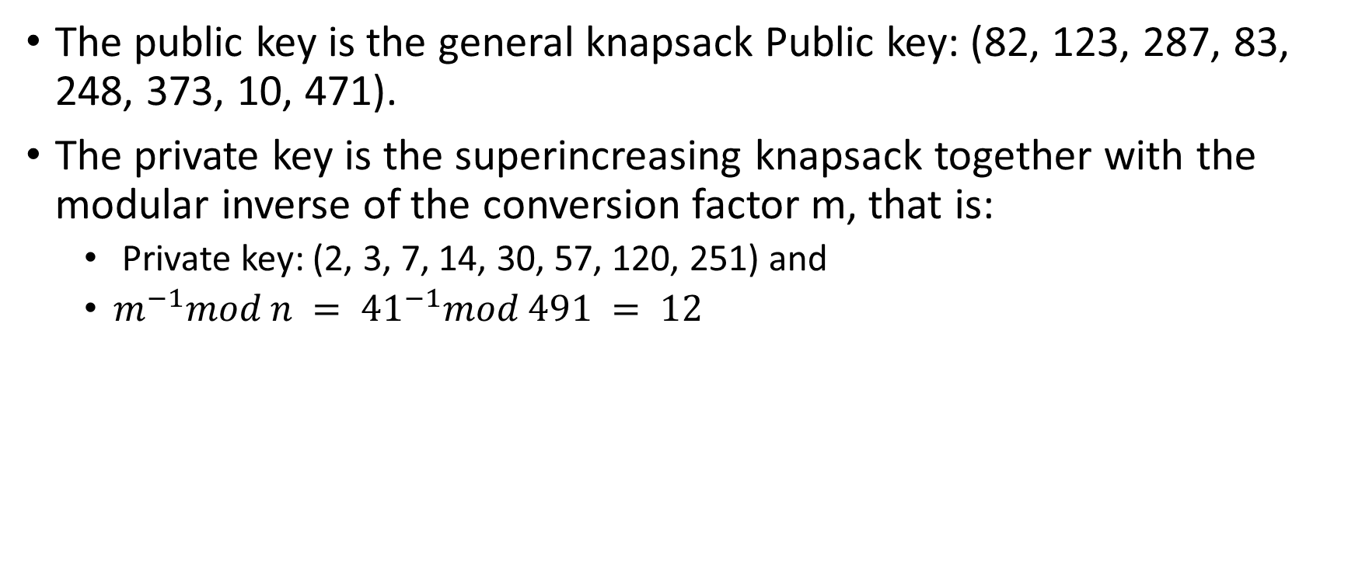
Example 2
The public key is the general knapsack Public key: (82, 123, 287, 83, 248, 373, 10, 471).
The private key is the superincreasing knapsack together with the modular inverse of the conversion factor m, that is:
Private key: (2, 3, 7, 14, 30, 57, 120, 251) and
$m^{−1}mod n = {41}^{−1}mod 491 = 12$

Slide 14
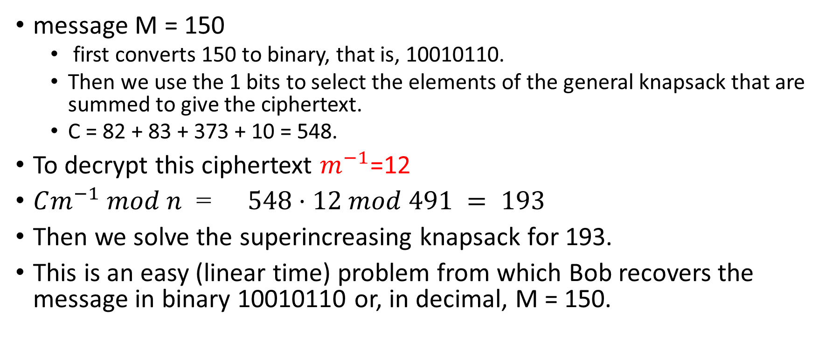
Example 2
message M = 150
first converts 150 to binary, that is, 10010110.
Then we use the 1 bits to select the elements of the general knapsack that are summed to give the ciphertext.
C = 82 + 83 + 373 + 10 = 548.
To decrypt this ciphertext $m^{−1}$=12
$Cm^{−1} mod n$ =$548·12 mod 491 = 193$
Then we solve the superincreasing knapsack for 193.
This is an easy (linear time) problem from which Bob recovers the message in binary 10010110 or, in decimal, M = 150.

Slide 15
RSA
To generate an RSA public and private key pair, choose two large prime numbers p and q and form their product N = pq.
Next, choose e relatively prime to (p − 1)(q − 1).
Find the multiplicative inverse of e modulo (p − 1)(q − 1), denote this inverse of e by d.
At this point, we have N = pq, as well as e and d, which satisfy ed = 1 mod (p − 1)(q − 1).
The number N is the modulus, whereas e is the encryption exponent and d is the decryption exponent.
The RSA key pair consists of
Public key: (N , e)
Private key: d.
Notes:
RSA is named after its putative inventors, Rivest, Shamir, and Adleman.

Slide 16
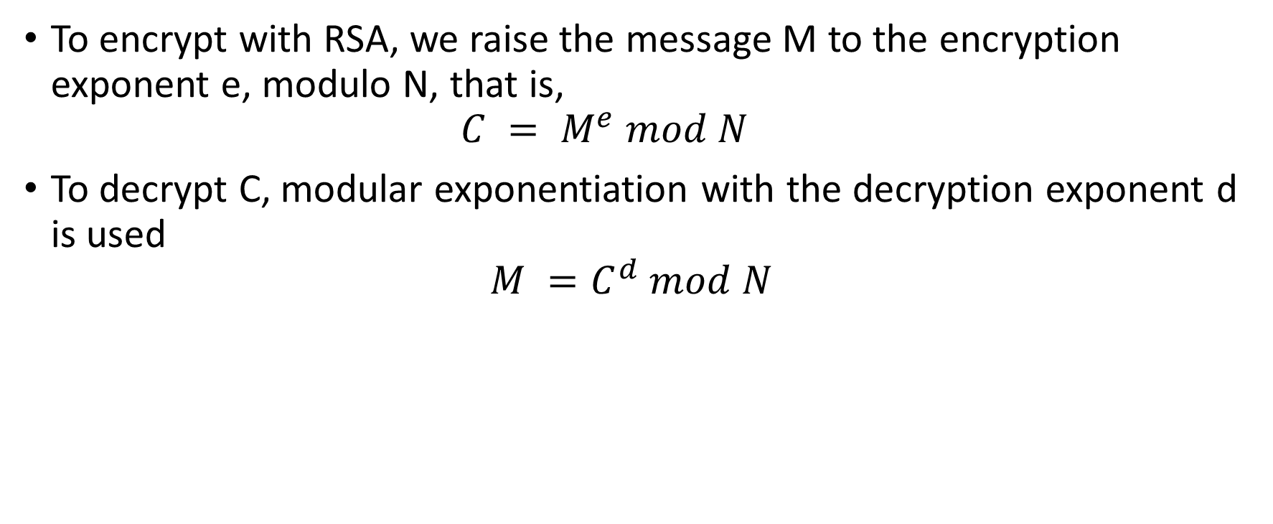
RSA
To encrypt with RSA, we raise the message M to the encryption exponent e, modulo N, that is,
$$C = M^{e} mod N$$
To decrypt C, modular exponentiation with the decryption exponent d is used
$$M =C^{d} mod N$$

Slide 17
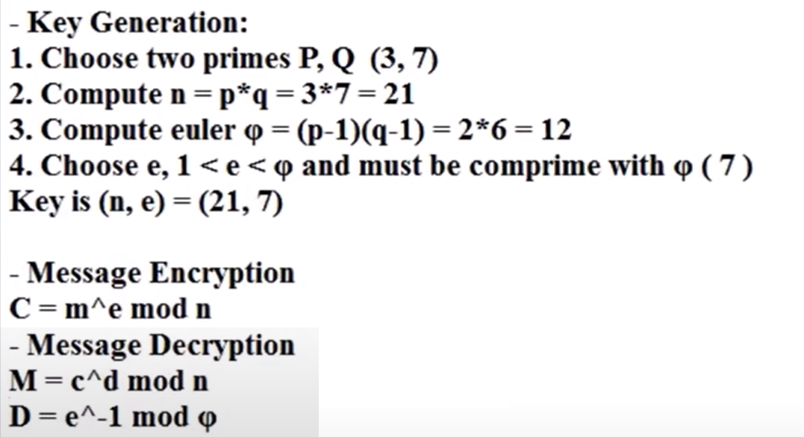
RSA

Slide 18
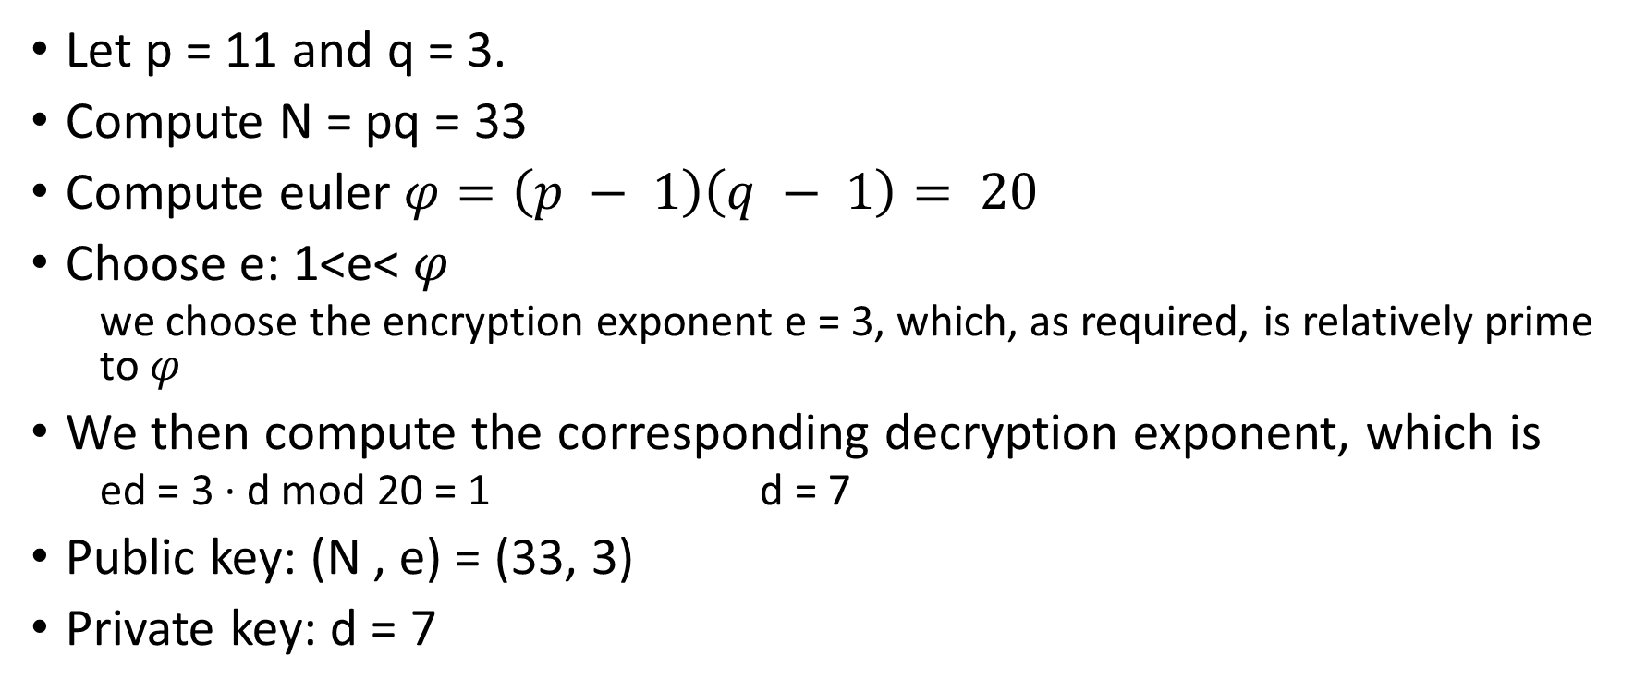
Example
Let p = 11 and q = 3.
Compute N = pq = 33
Compute euler $φ=\left(p − 1\right)\left(q − 1\right)= 20$
Choose e: 1<e< $φ$
we choose the encryption exponent e = 3, which, as required, is relatively prime to $φ$
We then compute the corresponding decryption exponent, which is
ed = 3 · d mod 20 = 1 d = 7
Public key: (N , e) = (33, 3)
Private key: d = 7

Slide 19
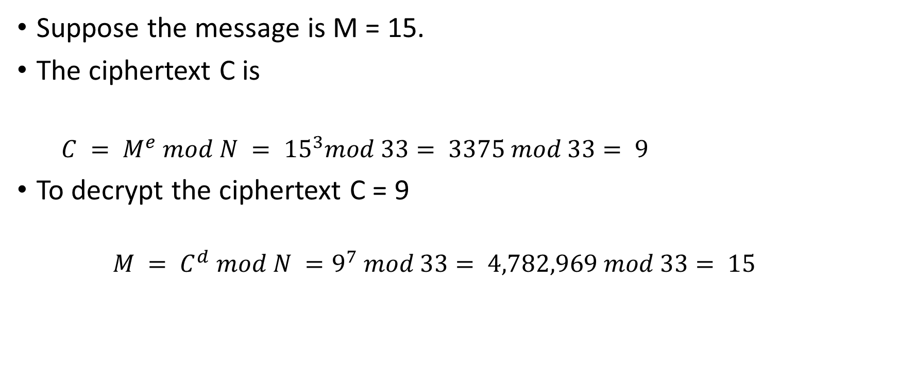
Example
Suppose the message is M = 15.
The ciphertext C is
$C = M^{e} mod N = {15}^{3}mod 33= 3375 mod 33= 9$
To decrypt the ciphertext C = 9
$$M = C^{d} mod N =9^{7} mod 33= 4,782,969 mod 33= 15$$

Slide 20
Example 2
Bob chooses 7 and 11 as p and q and calculates n = 77. The value of φ(n) = (7 − 1)(11 − 1) or 60. Now he chooses two exponents, e and d, from Z₆₀∗. If he chooses e to be 13, then d is 37. Note that e × d mod 60 = 1 (they are inverses of each Now imagine that Alice wants to send the plaintext 5 to Bob. She uses the public exponent 13 to encrypt 5.
Bob receives the ciphertext 26 and uses the private key 37 to decipher the ciphertext:

Slide 21
DIFFIE-HELLMAN
DH is a “key exchange” algorithm because it can only be used to establish a shared secret, which is generally then used as a shared symmetric key.
DH is not for encrypting, but instead it allows users to establish a shared secret.
This is no mean feat, since the key establishment problem is one of the fundamental pitfalls to symmetric key cryptography.

Slide 22
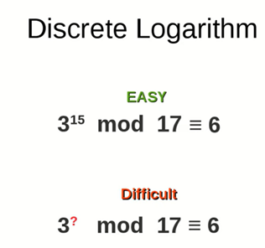
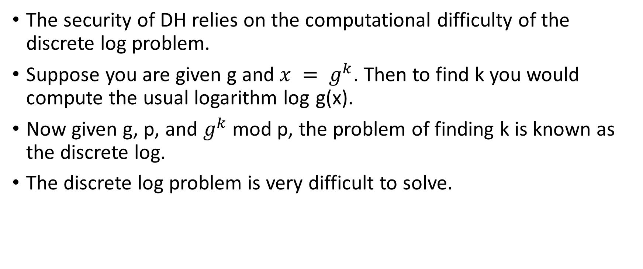
DIFFIE-HELLMAN
The security of DH relies on the computational difficulty of the discrete log problem.
Suppose you are given g and $x = g^{k}$. Then to find k you would compute the usual logarithm log g(x).
Now given g, p, and $g^{k}$ mod p, the problem of finding k is known as the discrete log.
The discrete log problem is very difficult to solve.

Slide 23
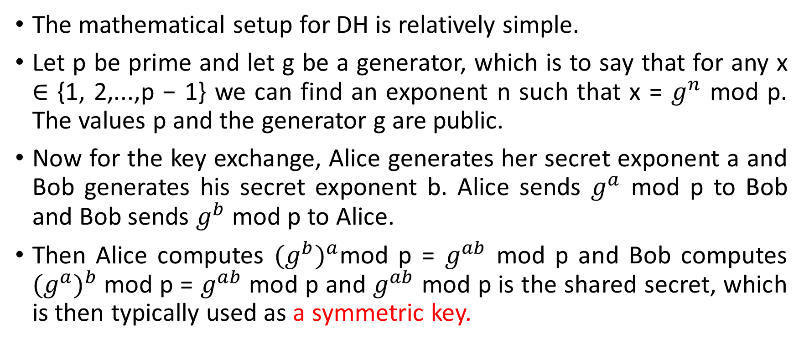
DIFFIE-HELLMAN
The mathematical setup for DH is relatively simple.
Let p be prime and let g be a generator, which is to say that for any x ∈ {1, 2,...,p − 1} we can find an exponent n such that x = $g^{n}$ mod p. The values p and the generator g are public.
Now for the key exchange, Alice generates her secret exponent a and Bob generates his secret exponent b. Alice sends $g^{a}$ mod p to Bob and Bob sends $g^{b}$ mod p to Alice.
Then Alice computes ${(g^{b})}^{a}$mod p = $g^{ab}$ mod p and Bob computes ${(g^{a})}^{b}$mod p = $g^{ab}$ mod p and $g^{ab}$ mod p is the shared secret, which is then typically used as a symmetric key.

Slide 24
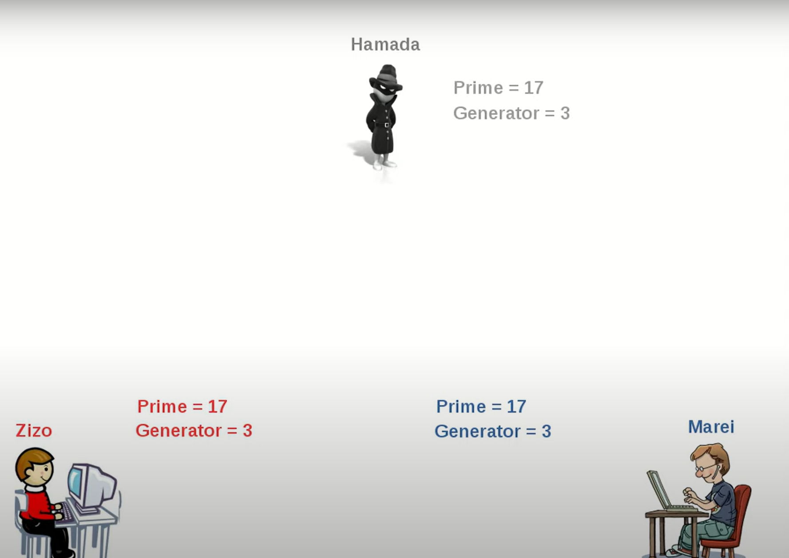

Slide 25
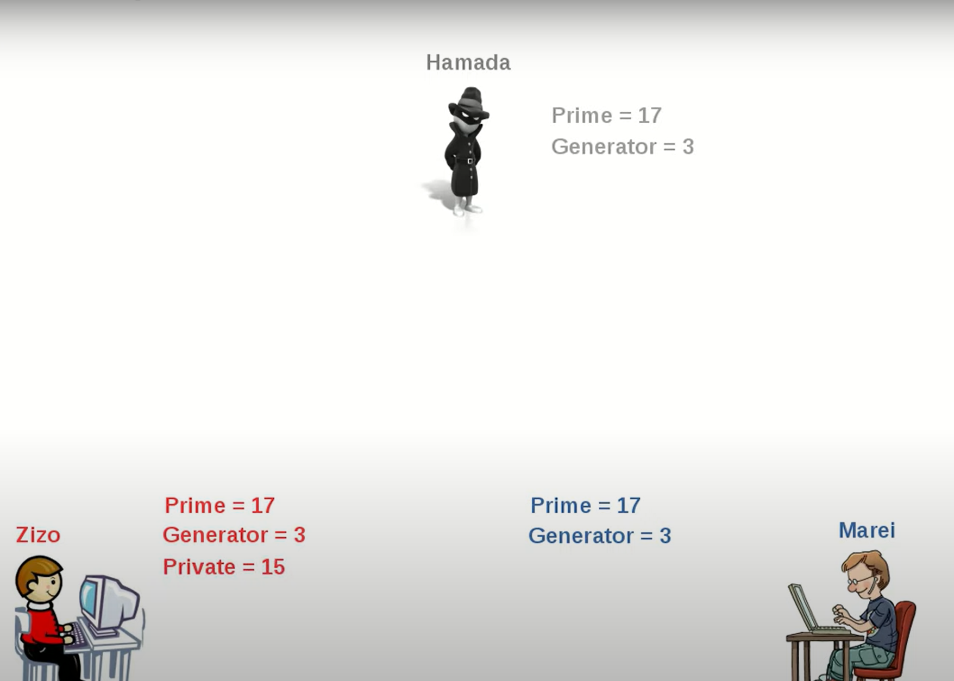

Slide 26
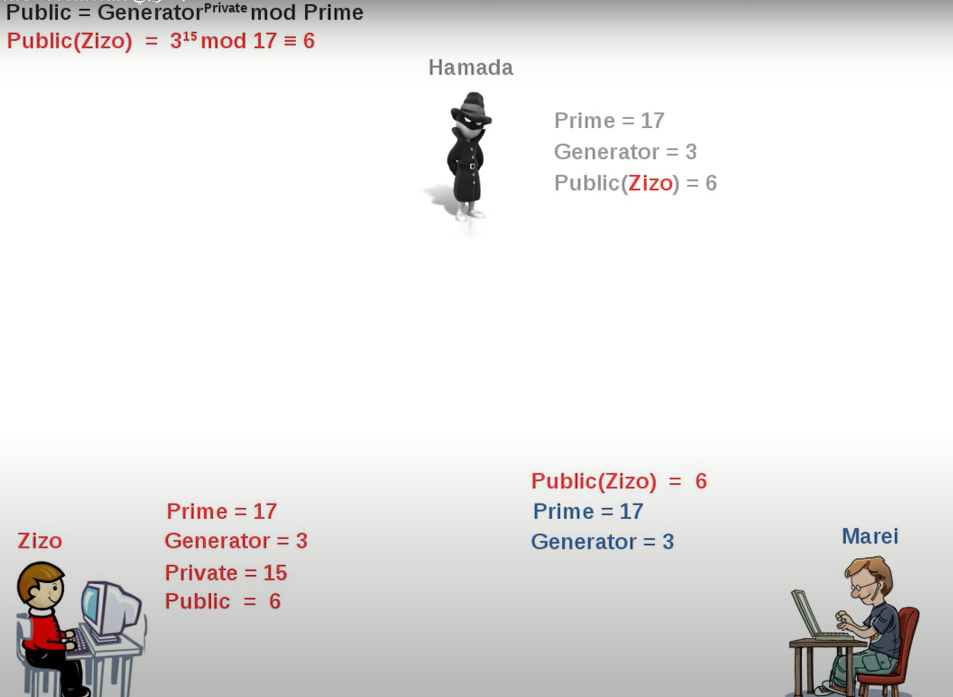

Slide 27
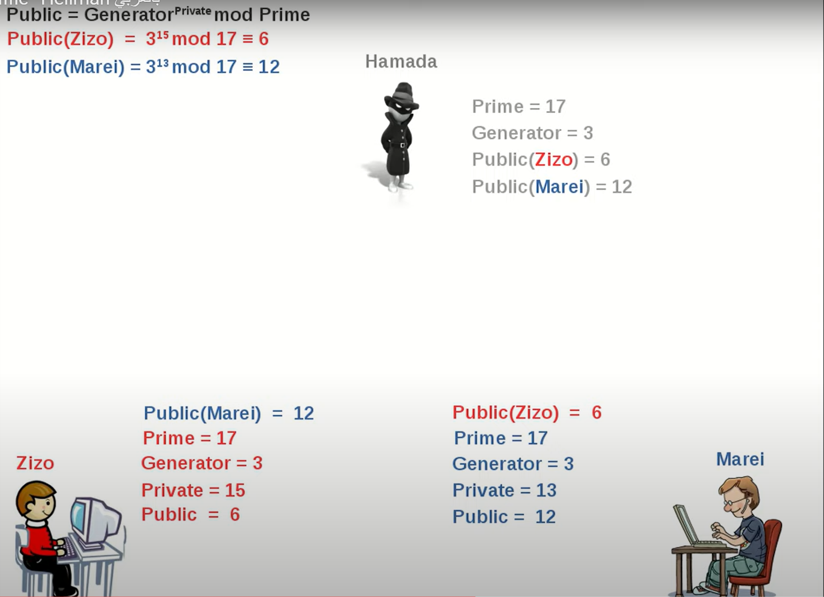

Slide 28
